Slide 1
SPACE MISSION
🚀
ANALYTICAL DASHBOARDS
End-to-End Data Pipeline · MySQL · Power BI · 5-Page Dashboard
1,584
7
68
333
47
Missions
Countries
Years
Rockets
Launch Sites
Dataset: 1,584 Records | 1957–2025 | 23 Columns | 36→23 Cleaned | 7 SQL Views

Slide 2
PROJECT INTRODUCTION
Slide 2 of 14
What is This Project About?
🎯 Objective
Analyse 68 years of global space missions to uncover patterns in launch activity, mission success rates, rocket reliability, and orbital strategy across 7 major space programs.
🛠️ Tools Used
Python (data cleaning) · MySQL (import, type conversion, SQL views) · Power BI Desktop (5-page interactive dashboard)
📦 Dataset
1,584 missions spanning 1957–2025. Original 36-column raw CSV cleaned to 23 final columns with 2 new derived fields (Decade, Spacecraft_Status).
🌍 Scope
7 country groups: USA, Russia/USSR, China, India, Europe/ESA, Japan, Other Countries. Covers all mission types from Military/Recon to Human Spaceflight.
📊 Deliverable
Interactive 6-page Power BI report (Home + 5 analysis pages) with 7 SQL views, 7 DAX measures, and synced global slicers.
2 / 14

Slide 3
DATASET OVERVIEW
Slide 3 of 14
23 Final Columns — By Group
Column Fill Rates
IDENTITY (4)
Mission_Name · Launch_Date · Launch_Year · Decade★
100% Complete
14 cols
GEOGRAPHY (3)
Country_Group · Country · Agency
65% Filled
2 cols
33% Filled
5 cols
VEHICLE (4)
Launch_Vehicle · Rocket_Family · Launch_Site · Launch_Complex
32% Filled
2 cols
MISSION (2)
Mission_Type (12 cats) · Orbit_Class (13 cats)
PHYSICAL (1)
Satellite_Mass_kg (32% filled — 512 rows)
Cleaning Summary
36 raw columns → 23 final columns
13 columns dropped (redundant / unusable)
7 columns normalised (types, categories)
2 new columns derived (Decade, Spacecraft_Status)
7 problem date rows fixed manually
Empty strings converted to NULL (launch_site)
Cost ranges converted to numeric midpoints
OUTCOME (2)
Mission_Outcome (4 groups) · Spacecraft_Status★
ECONOMICS (3)
Estimated_Cost_USD_M · Fuel_Type · Operational_Life_Yrs
METADATA (4)
Notes · Launch_ID · Data_Source · Dataset_Source
★ = newly derived column
3 / 14

Slide 4
DATA CLEANING PROCESS
Slide 4 of 14
1
2
3
4
5
Raw Import
CSV Import
Fix 7 Dates
Type Convert
Build Clean Table
Create missions_raw table with ALL columns as VARCHAR — guarantees zero import errors on any data format.
Import MASTER_CLEANED_FINAL.csv via MySQL Workbench Table Data Import Wizard into missions_raw.
Manually fix 7 problem rows (range dates, planned dates, mixed formats) by mission name using MAKEDATE().
Add clean columns, convert VARCHAR→DATE, SMALLINT, DECIMAL using STR_TO_DATE, CAST, NULLIF, TRIM.
CREATE missions_clean with proper data types. INSERT SELECT from missions_raw using converted columns.
Critical Concept — NULL vs Empty String vs 'Unknown'
State | Meaning | Correct SQL Filter | Example Column
NULL | No value — blank cell in CSV | WHERE col IS NOT NULL | satellite_mass_kg
Empty String "" | Cell existed with no content | WHERE col != "" | fuel_type
"Unknown" | Real text value = Unknown | WHERE col NOT IN ("Unknown") | orbit_class
4 / 14

Slide 5
DATA UNDERSTANDING — KEY FIELDS & STRUCTURE
Slide 5 of 14
Important Fields Explained
Data Pipeline
Country_Group
7 clean groups — primary slicer for all dashboards. Never use raw Country column in visuals.
6. missions_clean
1. Raw CSV (36 cols)
2. Python Cleaning
7. 7 SQL Views
Mission_Outcome
4 values: Success (86%), Failure (14%), Partial, Active. BepiColombo = Active (launched 2018).
3. 23-col CSV
8. Power BI Dashboard
4. MySQL Raw Table
Orbit_Class
13 types. Has 'Unknown' and 'Other' text — filter: NOT IN ('Unknown','Other').
5. Type Conversions
Fuel_Type
5 families. Missing stored as empty string '' not NULL — filter: fuel_type != ''.
Mission Outcome Split
Decade
Derived column: '1960s','1970s'… for decade-level grouping. 100% filled.
Spacecraft_Status
Derived: Decommissioned / Active / Lost-Failed / Planned. Only 33% filled.
Estimated_Cost_USD_M
Numeric midpoints from ranges. Only 503/1584 rows (32%) — always add coverage note.
5 / 14

Slide 6
EXPLORATORY DATA ANALYSIS — KEY INSIGHTS
Slide 6 of 14
Missions by Decade
Success Rate % by Country
Total Missions by Country
Top Orbit Classes
6 / 14

Slide 7
SQL VIEWS CREATION — 7 VIEWS FOR POWER BI
Slide 7 of 14
vw_mission_summary
vw_orbit_analysis
Core flat table — all 23 key columns. Used by most visuals across all 5 pages.
Orbital distribution — mission count, avg mass, success rate per orbit class.
Filter: launch_year <= 2025, NULLIF(launch_site, '')
Filter: orbit_class NOT IN ('Unknown','Other')
vw_country_performance
vw_launch_site_map
Country KPIs — total missions, success rate, avg cost, type diversity per country group.
Geographic data — 47 launch sites with coordinates, success rate, first/last launch year.
Filter: launch_year <= 2025
Filter: launch_site IS NOT NULL AND != ''
vw_yearly_trends
vw_technology_evolution
Time series — missions and success rate by year, decade, and country for trend charts.
Fuel & propulsion trends — missions and avg cost by decade, fuel type, mission type.
Filter: launch_year IS NOT NULL AND <= 2025
Filter: fuel_type != '' AND decade IS NOT NULL
Key Principle — Each view uses the correct WHERE filter based on how that column stores missing data (NULL vs '' vs 'Unknown'). Wrong filter = wrong numbers.
vw_rocket_reliability
Vehicle analysis — reliability %, total launches, payload avg. HAVING total_launches >= 3.
Filter: launch_year <= 2025, min 3 launches
7 / 14

Slide 8
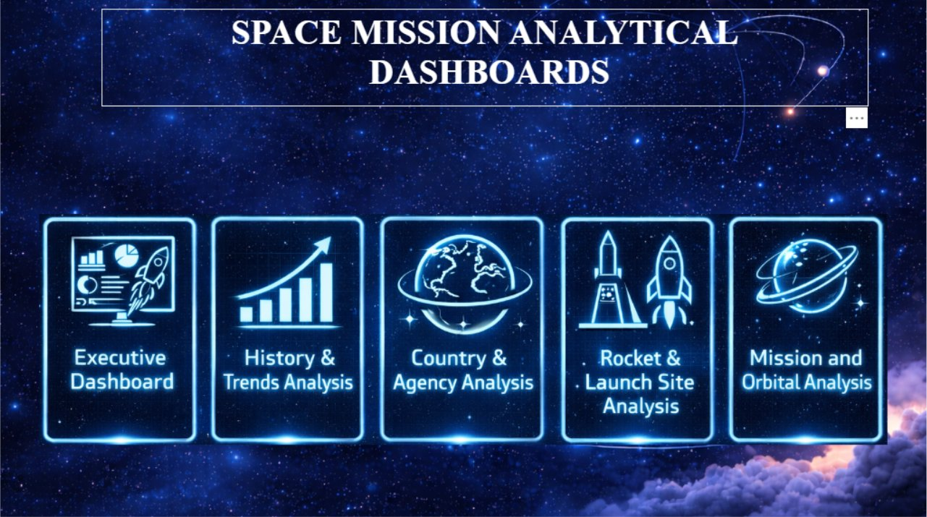
DASHBOARD DEVELOPMENT — 5-PAGE DESIGN
Slide 8 of 14
6-Page Report Structure
🏠 Home
Navigation hub with 5 dashboard buttons
🌍 Page 1
Executive Overview — KPIs + trends
📅 Page 2
History & Trends — decade analysis
🌐 Page 3
Country & Agency — deep dive
🚀 Page 4
Rockets & Launch Sites
🛸 Page 5
Mission & Orbital Analysis
Global Slicers — Synced Across All 5 Pages
7 DAX Measures
country_group · launch_year (range) · decade (tiles) · mission_outcome · mission_type
Total Missions · Success Rate % · Failure Rate %
Avg Mass kg · Avg Cost USD M
Missions With Cost · Cumulative Missions
Enable sync: View → Sync Slicers → tick all 5 pages for each slicer
8 / 14

Slide 9
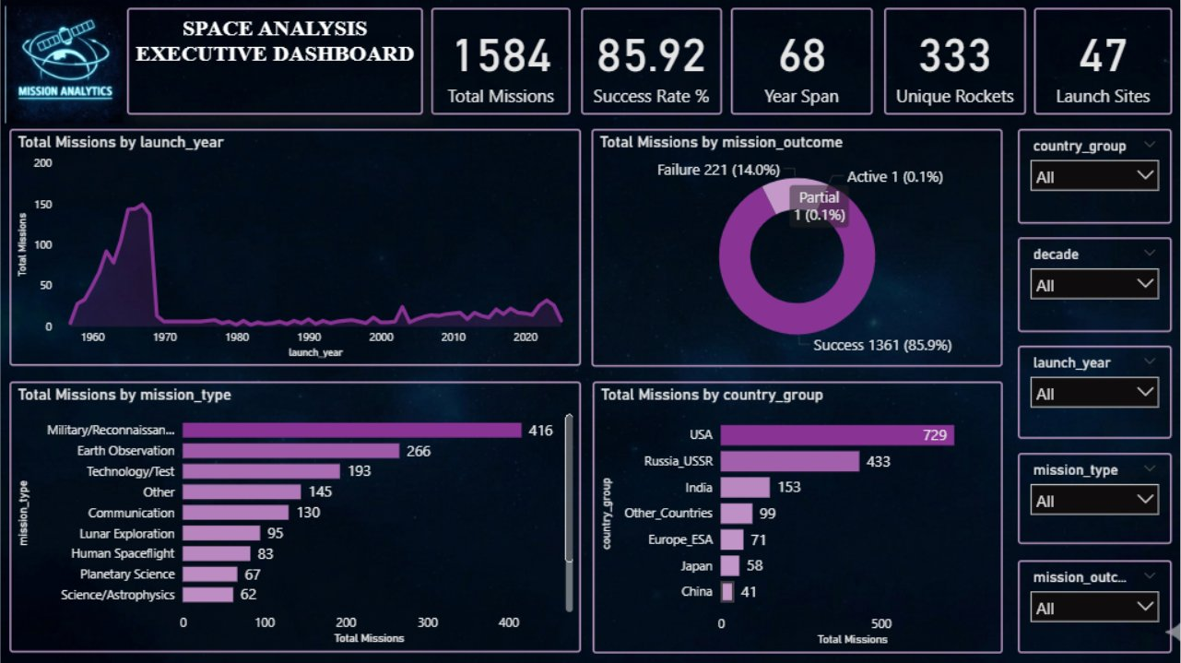
DASHBOARD 1 — EXECUTIVE OVERVIEW
Page 1 of 5
1,584
85.9%
68 Yrs
333
Total Missions
Success Rate
Year Span
Unique Rockets
Key Insights
📌 USA Leads
729 missions — 46% of all launches. Followed by Russia/USSR with 433 (27%).
📉 Space Race Peak
1960s account for 976 missions — more than all other decades combined.
✅ High Success
1,361 successes vs 221 failures. Overall success rate of 85.9%.
🛰️ Mission Mix
Military/Recon (26%) and Earth Observation (17%) dominate mission types.
9 / 14

Slide 10
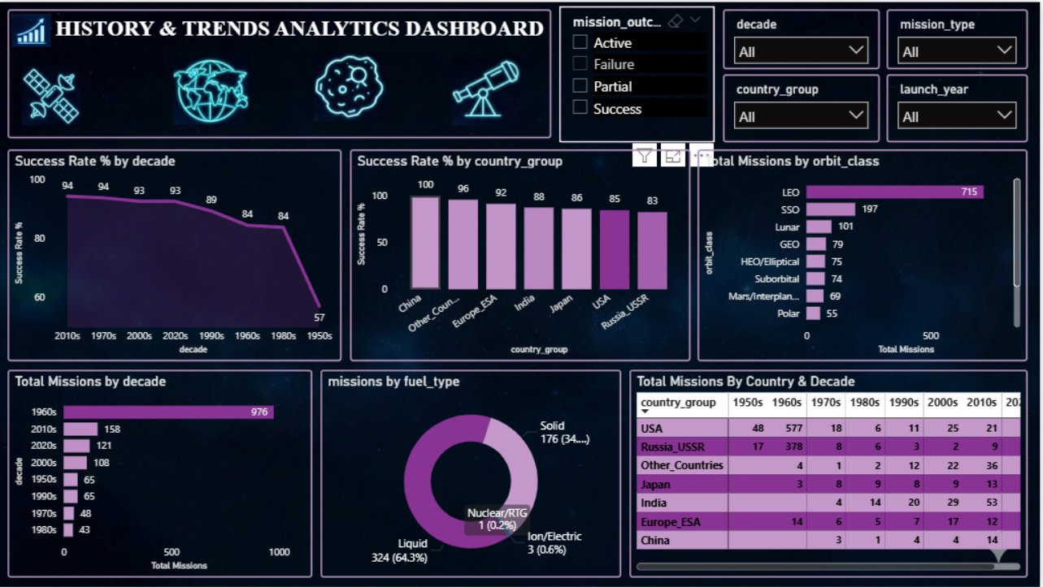
DASHBOARD 2 — HISTORY & TRENDS ANALYSIS
Page 2 of 5
57%
94%
976
64%
1950s Success Rate
2010s Success Rate
1960s Missions
Liquid Fuel Share
Key Insights
📈 Dramatic Improvement
Success rate rose from 57% in the 1950s to 94% in the 2010s — a 37-point gain.
🌡️ Cold War Spike
1960s Space Race drove an unprecedented volume peak — 62% of all recorded missions.
🔋 Fuel Shift
Liquid propellant dominates at 64%. Ion/Electric engines rising sharply from 2010s onward.
🗺️ Country Heatmap
Russia/USSR was absent post-2010s in the matrix — replaced by China's rapid expansion.
10 / 14

Slide 11
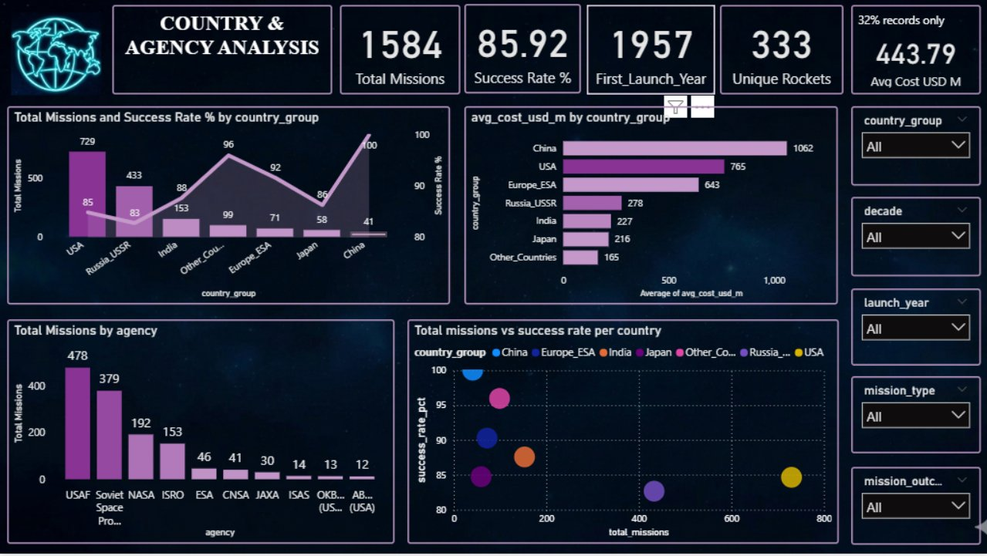
DASHBOARD 3 — COUNTRY & AGENCY ANALYSIS
Page 3 of 5
100%
$1,062M
$227M
478
China Success Rate
China Avg Cost (highest)
India Avg Cost (lowest)
USAF Missions (top agency)
Key Insights
🏆 China Perfection
China achieved a 100% success rate across all 41 recorded missions — most remarkable record.
📊 ISRO Rising
India's ISRO shows the steepest modern growth — 88% success on significantly lower budgets.
💰 Cost Leaders
China avg $1,062M is highest; India $227M is lowest — over 4x difference in cost efficiency.
🏛️ Agency Dominance
USAF (478) and Soviet Space Program (379) collectively account for 54% of all missions.
11 / 14

Slide 12
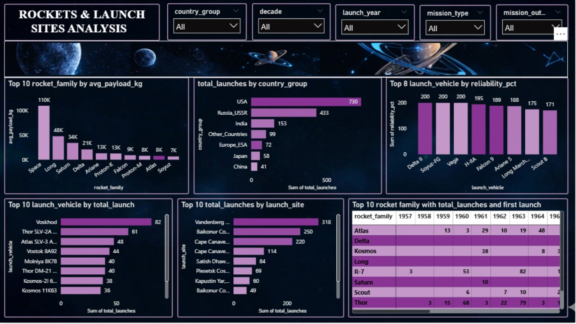
DASHBOARD 4 — ROCKETS & LAUNCH SITES
Page 4 of 5
82
318
95%+
333
Voskhod Launches (most used)
Vandenberg Launches (top site)
Delta II / Soyuz-FG Reliability
Unique Rocket Variants
Key Insights
🚀 Most Flown
Voskhod leads with 82 launches. Top 5 rockets are all Cold War-era US/Soviet vehicles.
📍 Top 3 Sites
Vandenberg (318), Baikonur (250) and Cape Canaveral (220) — 3 sites = 50% of all launches.
🛡️ High Reliability
Delta II, Soyuz-FG, Vega and H-IIA all exceed 95% reliability — proven veteran platforms.
⚡ Falcon 9 Era
The matrix shows Falcon 9 emergence in 2010s — representing the commercial reusable revolution.
12 / 14

Slide 13
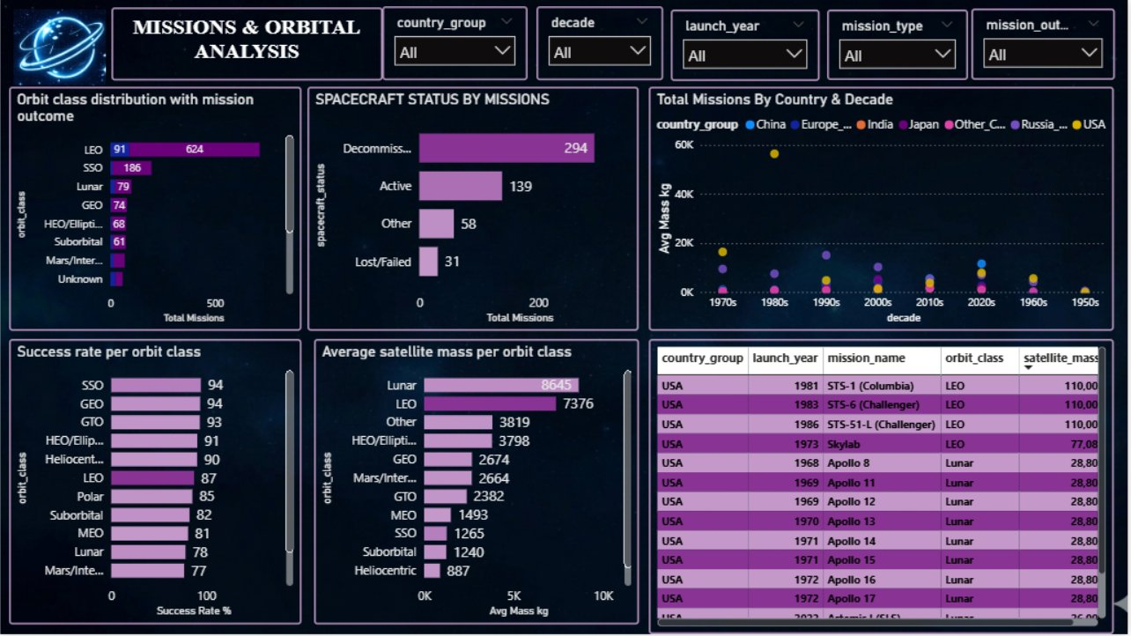
DASHBOARD 5 — MISSION & ORBITAL ANALYSIS
Page 5 of 5
715
94%
8,645 kg
77%
LEO Missions (45% of total)
SSO Success Rate (highest)
Avg Lunar Payload (heaviest)
Mars Success Rate (lowest)
Key Insights
🌍 LEO Dominates
Low Earth Orbit hosts 715 missions (45%) — driven by ISS, Earth observation, and cubesats.
🎯 SSO Precision
Sun-synchronous orbit has the highest success rate at 94% — well-understood and repeatable.
🌕 Lunar Heavy
Lunar missions carry the heaviest average payloads at 8,645 kg due to propulsion demands.
📉 Mars is Hard
Mars/Interplanetary has the lowest success at 77% — deep-space navigation remains the frontier.
13 / 14

Slide 14
INSIGHTS, CONCLUSION & RECOMMENDATIONS
Slide 14 of 14
Key Insights
Conclusion
🏆 Success Rate
China achieved 100% success rate. Russia/USSR lowest at 83%, reflecting early Cold War failures.
Successfully cleaned 36-column raw dataset to 23 production-ready columns.
MySQL import pipeline with proper type handling eliminates all data errors.
7 SQL views provide clean, filtered data optimised for each dashboard page.
5-page Power BI dashboard delivers actionable insights with global slicer sync.
88% of missions are fully verified via Launch Library 2 UUID traceability.
📈 Space Race Peak
1960s had 976 missions — 62% of all missions. Decade accounts for biggest spike in launch activity.
🚀 Most Launched
Voskhod (82 launches) is the most used rocket. USA and Russia dominate top 10 vehicles.
🌍 Launch Sites
Vandenberg (318), Baikonur (250) and Cape Canaveral (220) are the top 3 sites globally.
Recommendations & Future Scope
🛸 Orbit Preference
LEO dominates at 715 missions (45%). SSO, Lunar and GEO follow as next most used orbits.
Fill cost data gaps using public sources to increase 32% coverage.
Add launch coordinates for all 47 sites to enable accurate map visuals.
Automate monthly data refresh by connecting to Launch Library 2 API.
Add crew manifest data to enhance Human Spaceflight mission analysis.
Build ML model to predict mission success probability from vehicle + orbit.
Expand to include payload operator and customer for commercial analysis.
💰 Cost Data
Only 32% of missions have cost data. China avg $1,062M is highest, India lowest at $227M.
⚡ Fuel Evolution
Liquid fuel dominates (64%). Ion/Electric rising in 2010s-2020s for commercial satellites.
14 / 14

